Slide 1
Overdose in COVID World
Olawale Ojo MBChB, MSc

Slide 2
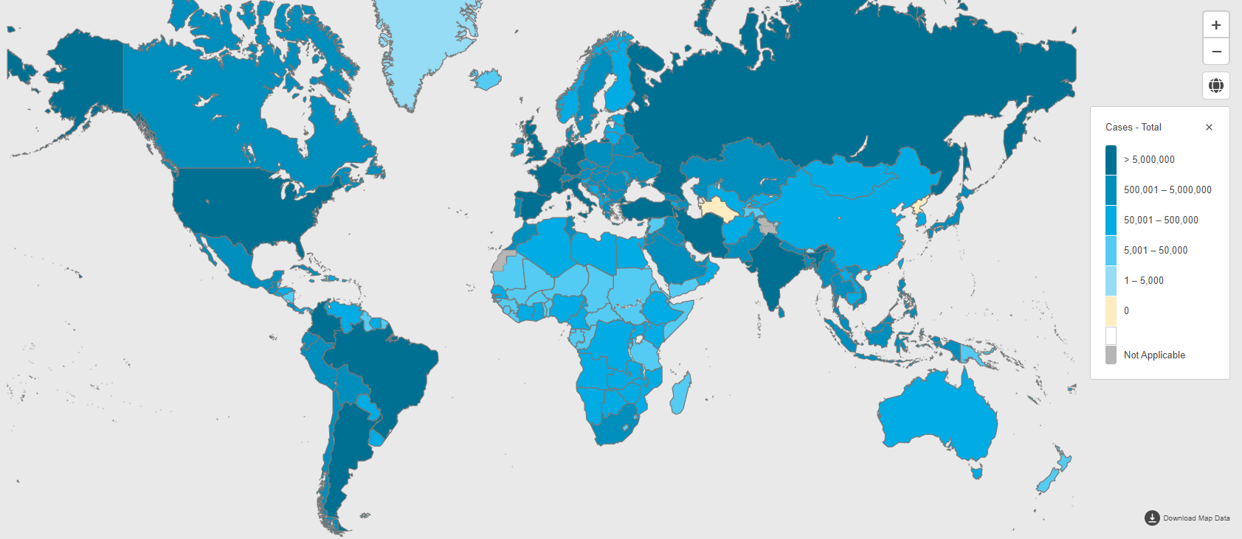

Slide 3
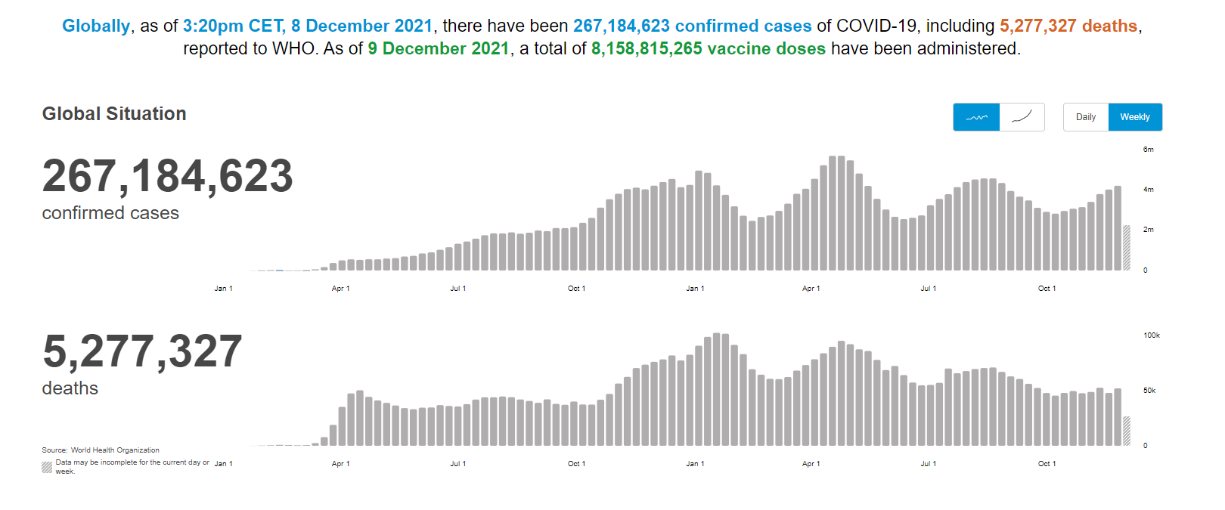

Slide 4
PANDEMIC RELATED PSYCHOLOGICAL STRESSORS
Social and emotional isolation
Financial stress
Childcare
Inadequate medical response
Limited distribution of resources

Slide 5
PANDEMICS AND MENTAL HEALTH
Sleep disturbances
Anger
Extreme fear
New onset Anxiety, Depression, PTSD, Somatization (Neria et al)
Exacerbation of existing mental disorder

Slide 6
Preexisting Pandemic?

Slide 7
Substance Use in the United States (Pre COVID-19)
841,000 people have died since 1999 from a drug overdose.
70,630 drug overdose deaths occurred in the United States in 2019.
The age-adjusted rate of overdose deaths increased by over 4% from 2018 (20.7 per 100,000) to 2019 (21.6 per 100,000).

Slide 8
SUD Before Covid-19
Majority of deaths from overdoses are opioid-related
Initially death were linked to opioid pain analgesics
Shifted to illicit opioids, such as heroin
Synthetic substances have been on the rise- opioids like fentanyl, stimulant (methamphetamine, cocaine)

Slide 9
A Pandemic Within a Pandemic
Bidirectional relationship between COVID-19 and addictions

Slide 10
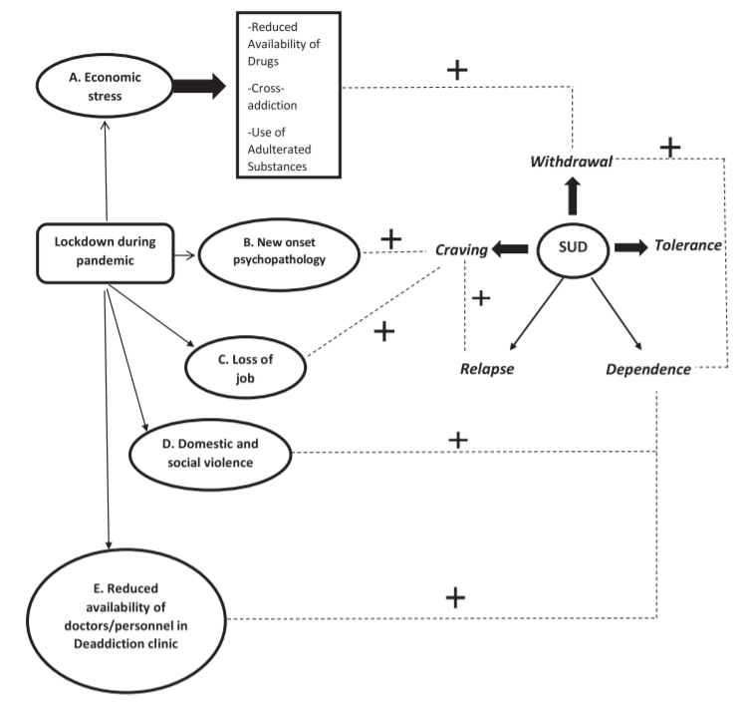
Bidirectional relationship between COVID-19 and addiction

Slide 11
SUD after Onset of Covid-19
People with SUD are at greater risk of worse COVID-19 outcome.
Surge of addictive behaviors (both new and relapse) including behavioral addiction in this period. 45/5
Withdrawal emergencies
Death are also being increasingly reported.
Difficulties in accessing the healthcare services

Slide 12
Emergency Services in Indianapolis 2020
Calls for service (EMS calls) after the lock-down order (March 2020) reopening in (May 2020)
All CFS - 4% increase
Overdose CFS- 43% increase
CFS Naloxone- 61% increase
Deaths – 47% increase

Slide 13
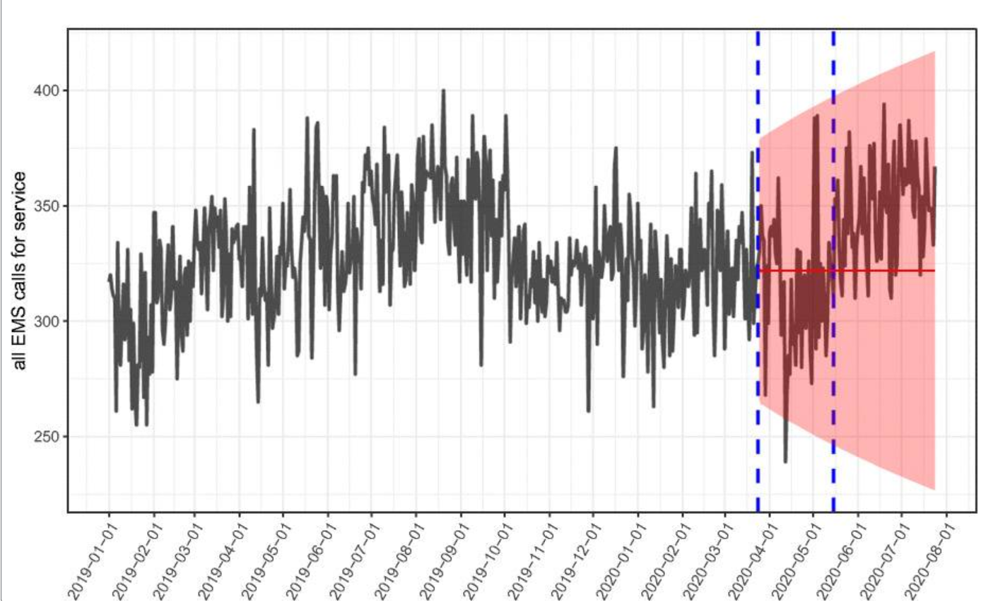
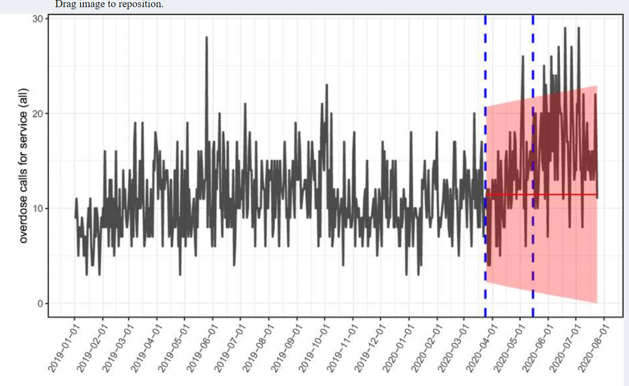
EMS Calls
EMS calls for service
Overdose calls

Slide 14
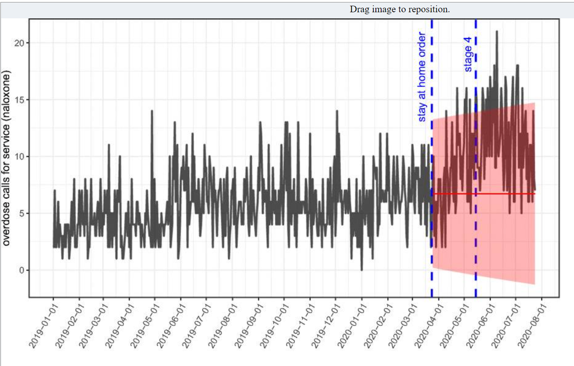
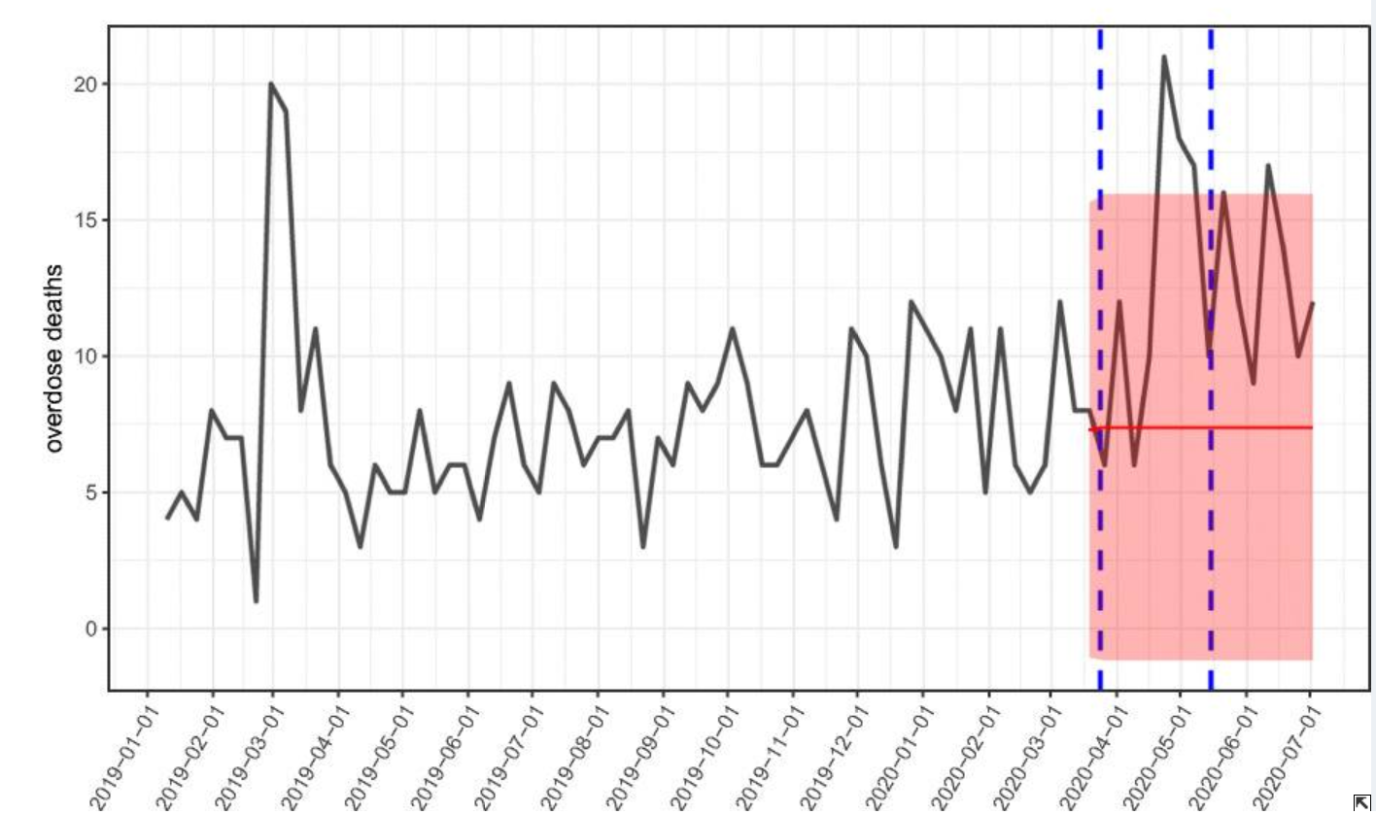
EMS Calls
Overdose-deaths

Slide 15
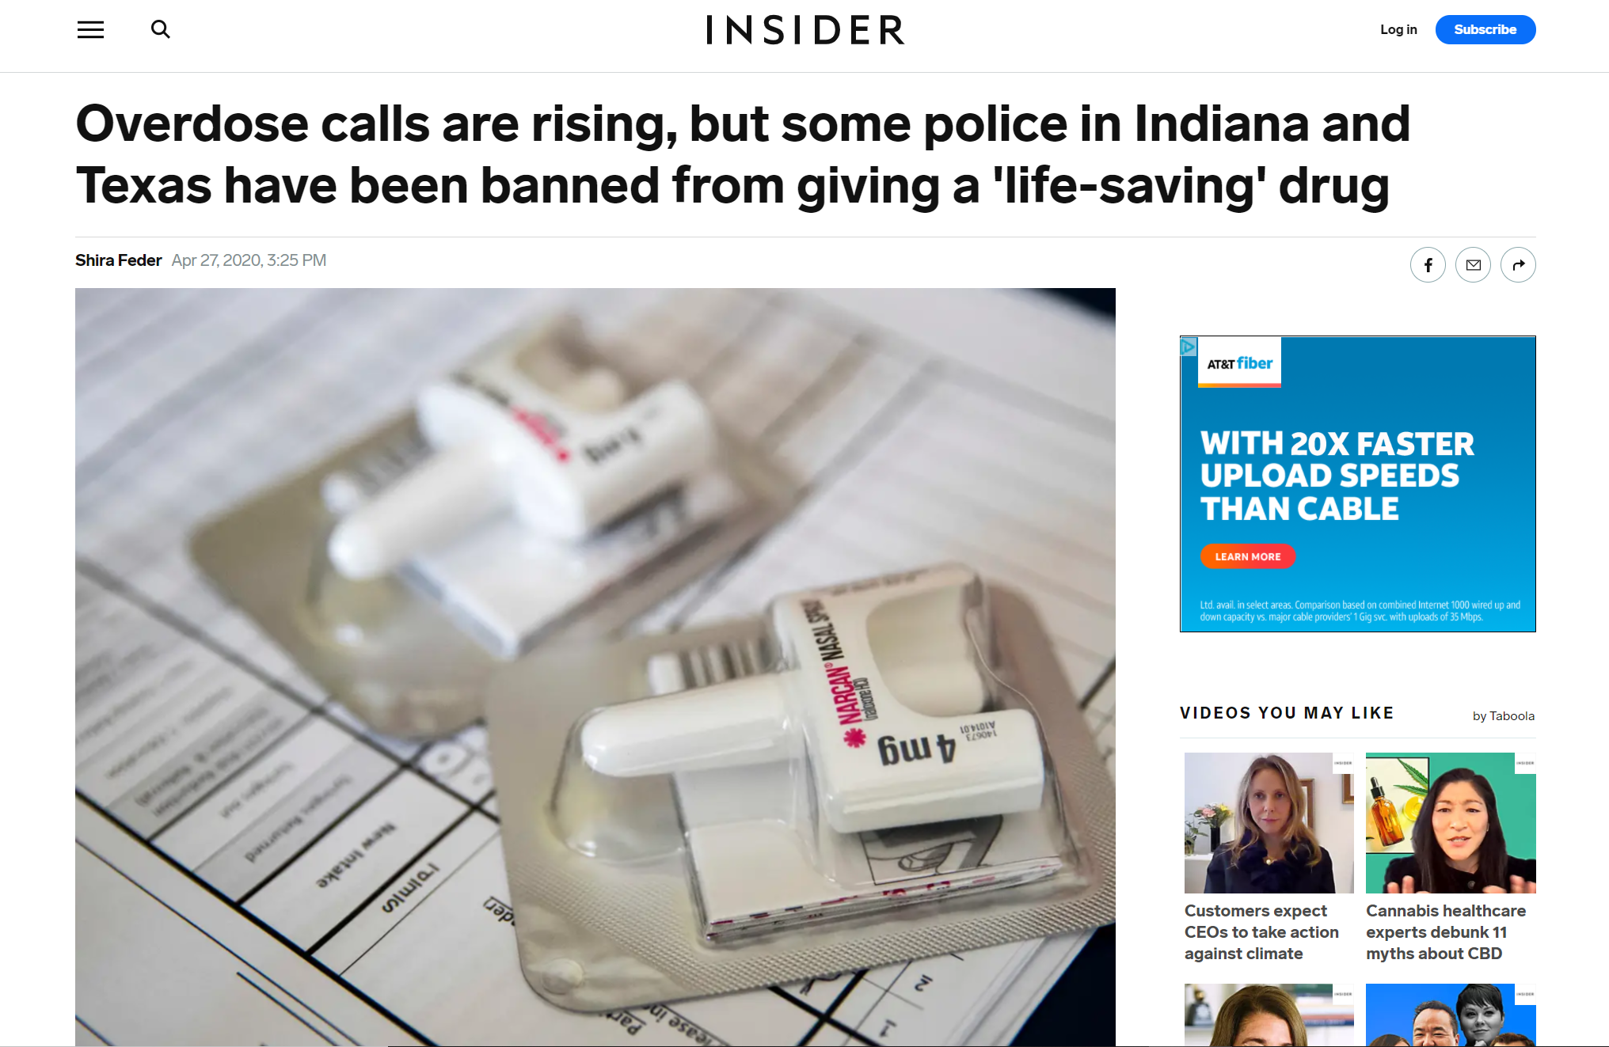
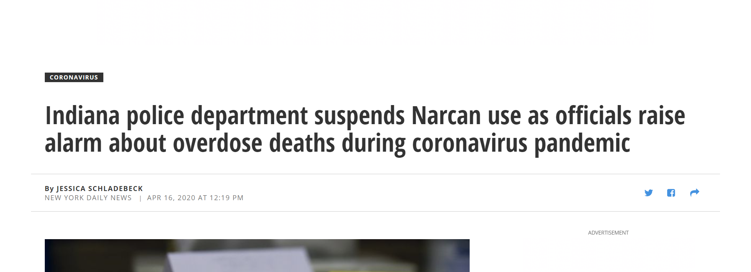
Controversies

Slide 16
ED VISITS AND NONFATAL OVERDOSES
Substantial decline in the number of total ED visits across the United States after January 2020
  delays in seeking care/interruption in health care delivery
  avoiding care
nonfatal overdoses did not decline at a similar pace

Slide 17
ED VISITS AND NON-FATAL OVERDOSE
Starting in May 2020, total ED visits began increasing but remained lower than months prior to March 2020.
During March through September 2020, compared to the previous time period, there were higher numbers of suspected overdose ED visits
Numbers of suspected all drug and opioid-involved overdoses were highest in July 2020 gradually declined during the following months, with numbers still higher in September 2020 than before March 2020.
Numbers of suspected heroin- and stimulant-involved overdoses were highest in May 2020, gradually declined during the following months, with numbers still higher in August 2020 than before March 2020.

Slide 18
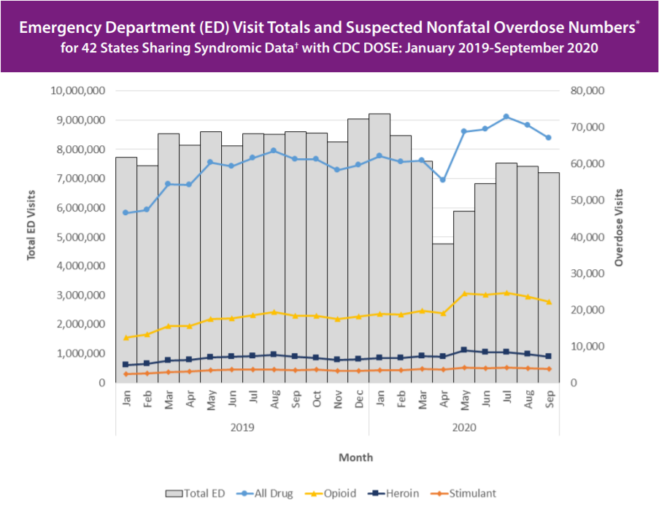

Slide 19
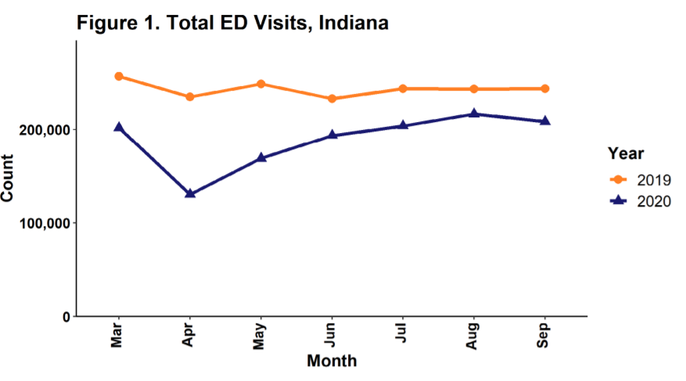

Slide 20
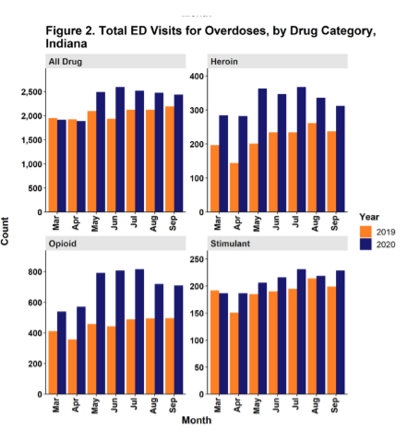
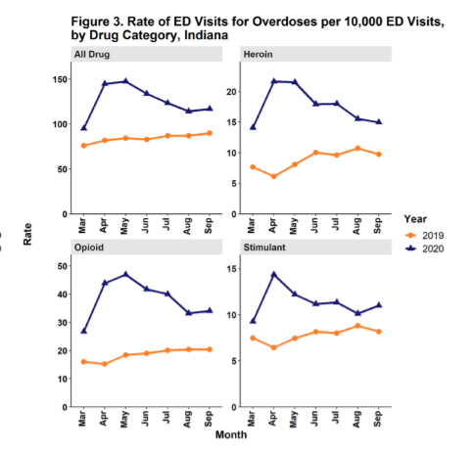
ED visits for overdose (Indiana)

Slide 21
Overdose deaths during COVID-19
93,000 died in 2020
29.4% increase from 2019
Highest number of overdose deaths in 12 months
Largest yearly increase since 1999
Overdose deaths primarily fentanyl
Increased deaths from natural and semi-synthetic opioids
Cocaine deaths also increased

Slide 22
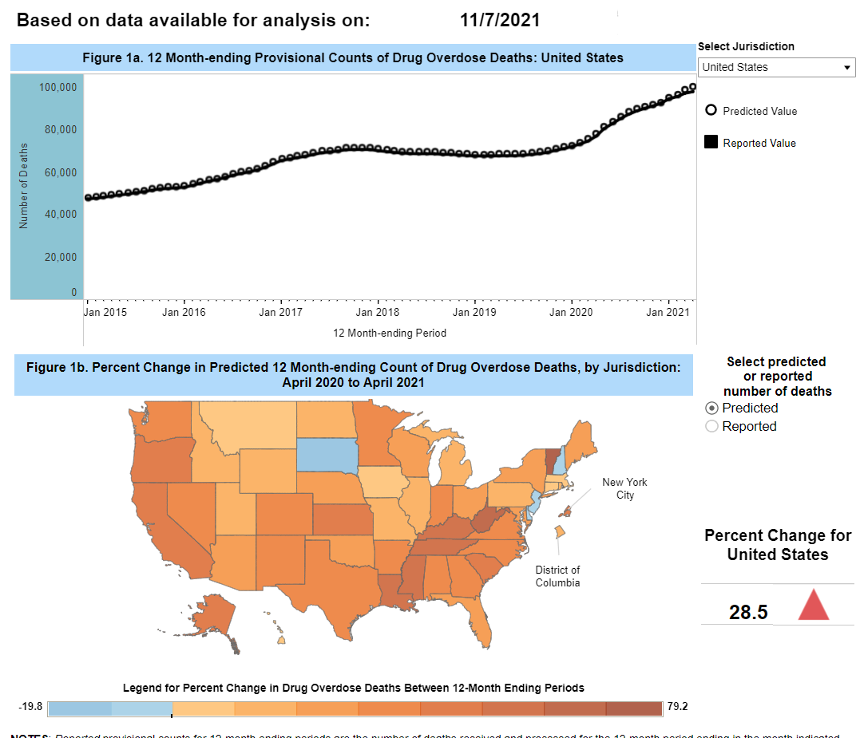

Slide 23
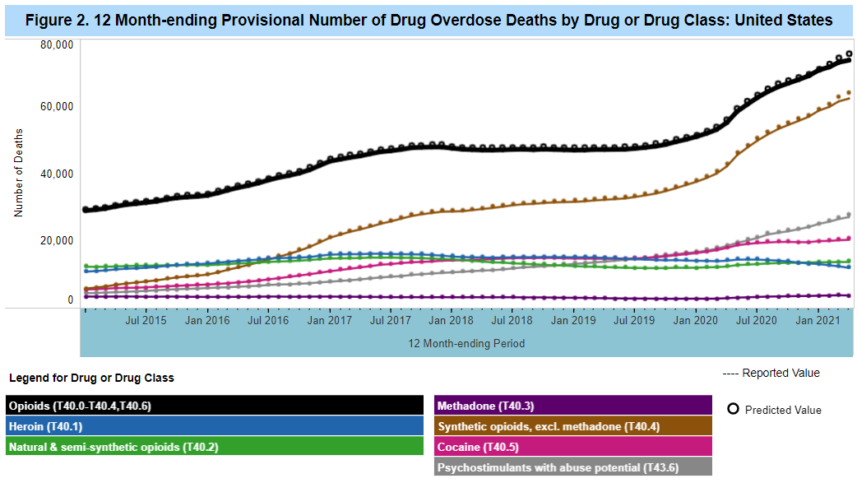

Slide 24
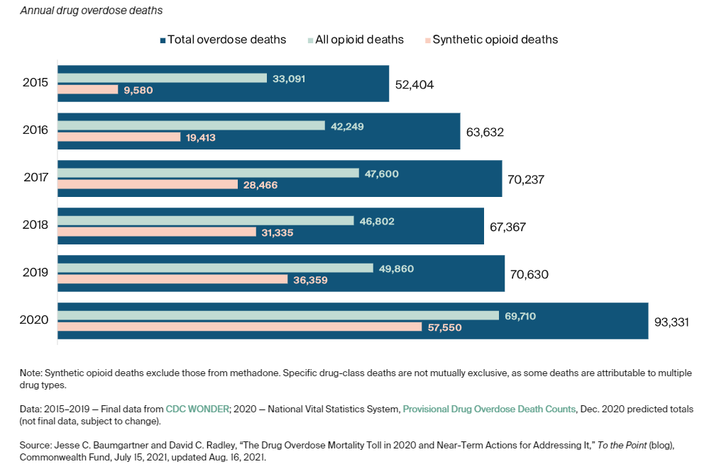

Slide 25
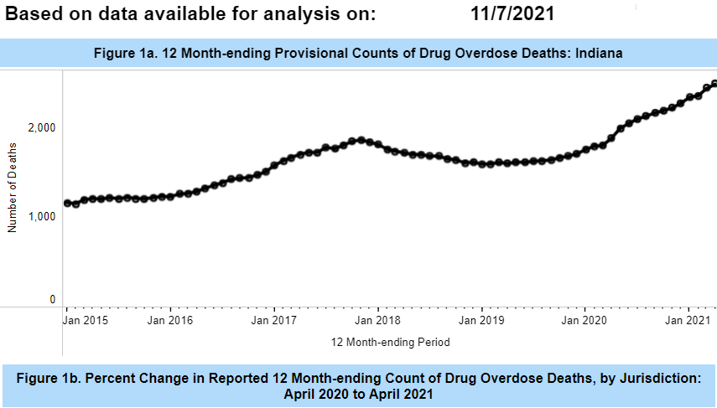
Overdose deaths in Indiana

Slide 26
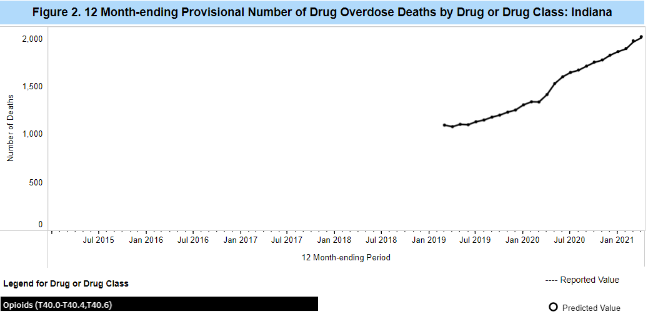

Slide 27
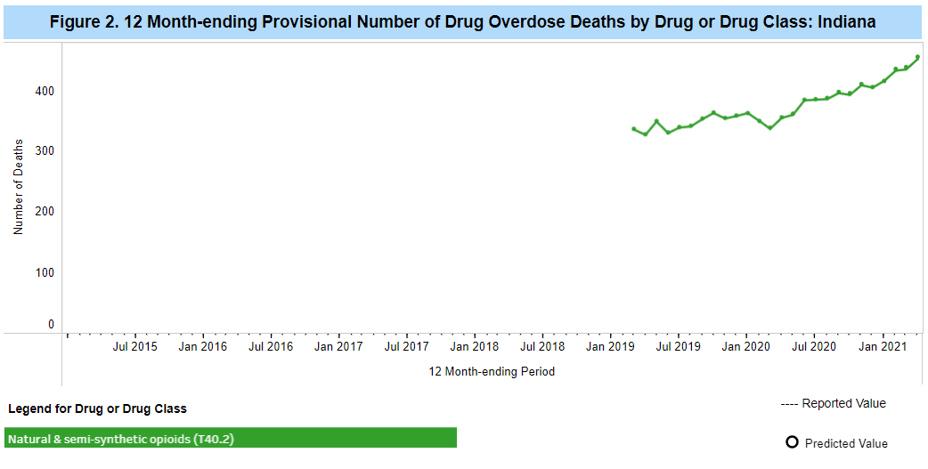

Slide 28
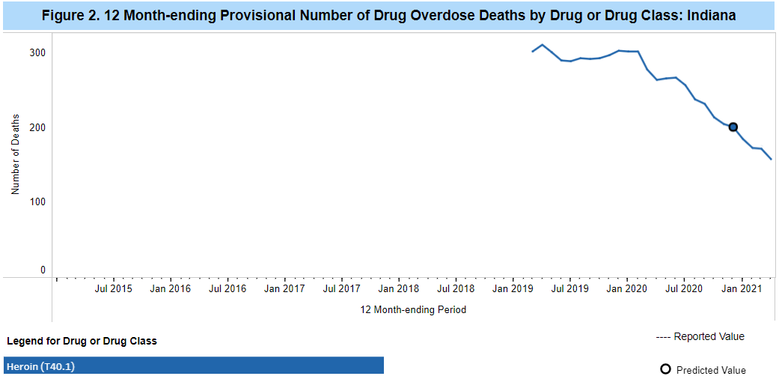

Slide 29
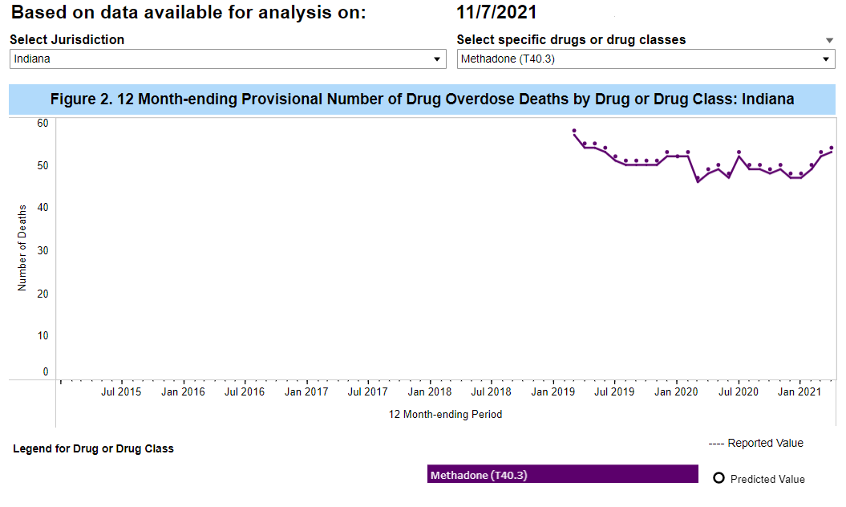

Slide 30
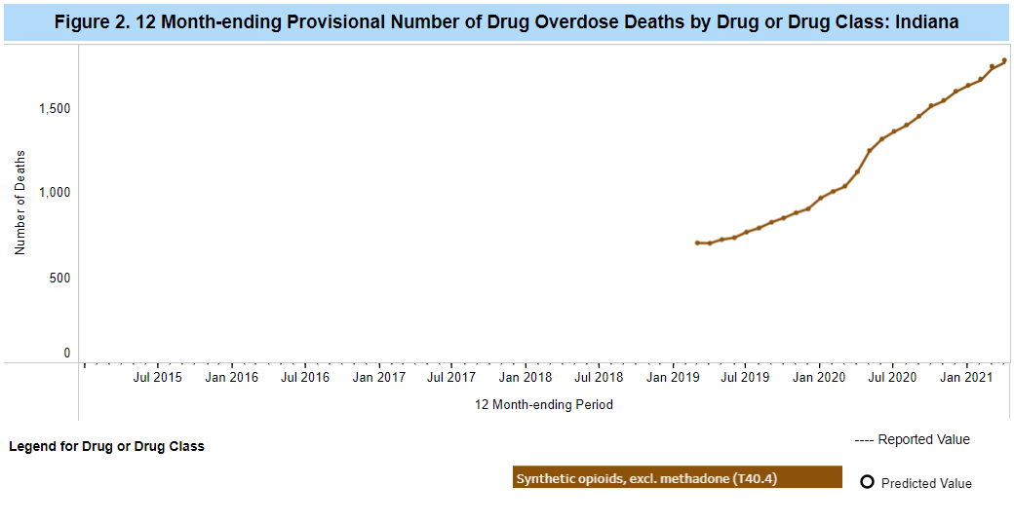

Slide 31
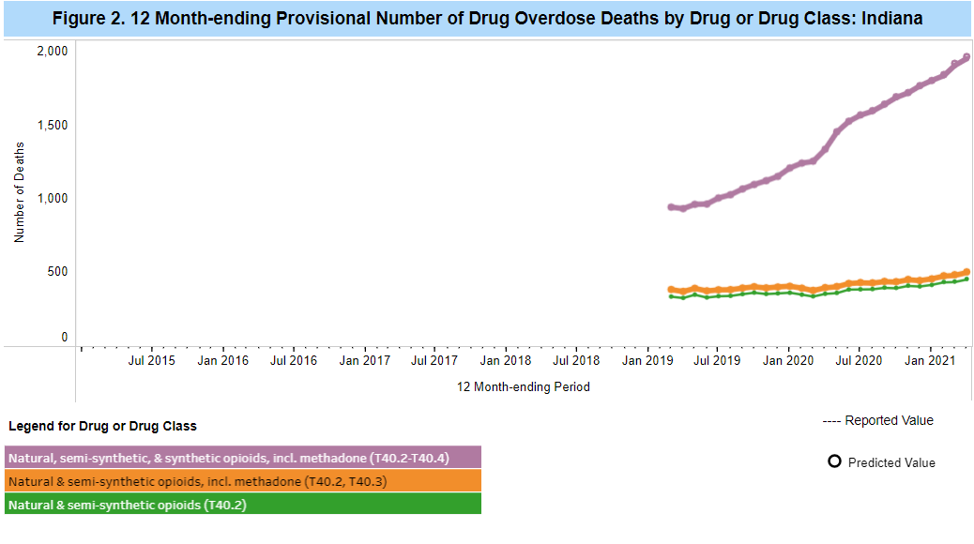

Slide 32
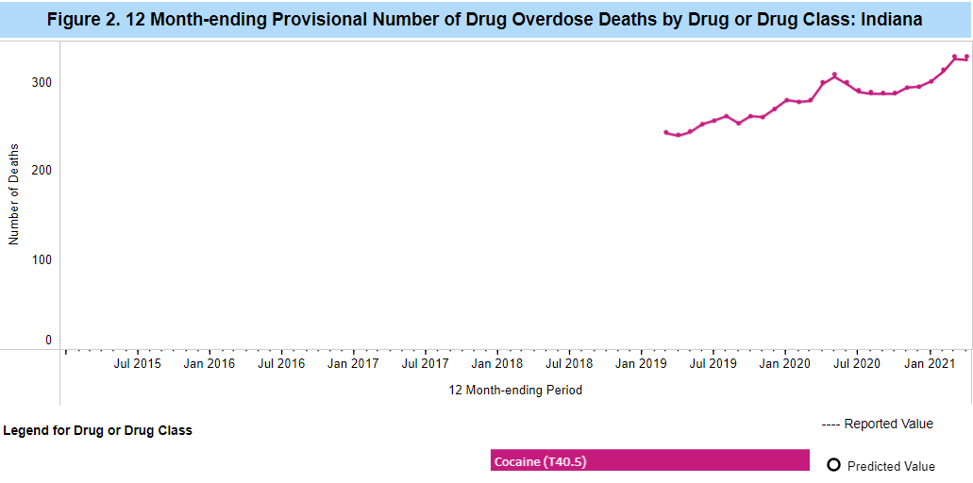

Slide 33
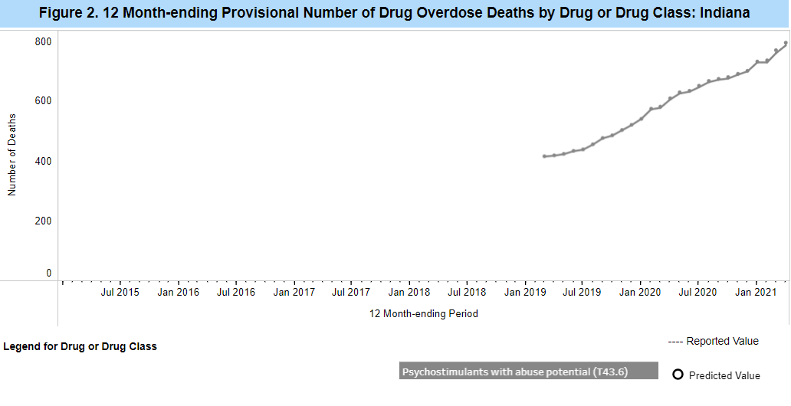

Slide 34
Adaptations and Responses
Conversion of addiction services (inpatient detox and rehab units) to cope with COVID-19 surge.
lifting requirement to perform an in-person physical evaluation for Buprenorphine but not methadone.
Home induction of Suboxone
Workflow issues at Methadone programs
Methadone- “Emergency bottles” Up to 28-day for stable patient and a 14-day course for patients who are less stable
Monitoring and testing- paused/less frequent/less random
Telepsychiatry

Slide 35
Impact and Implications
Let’s take a closer look at the mortality rates

Slide 36
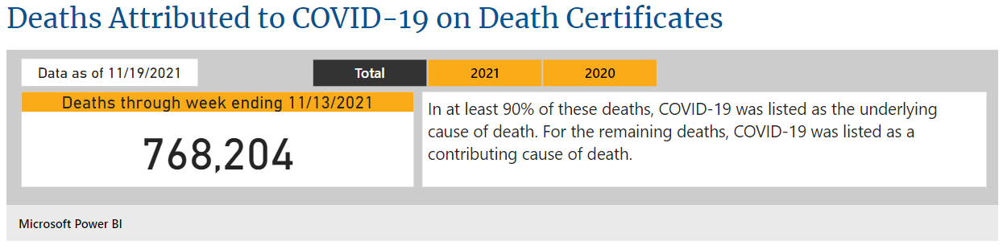
Covid-19 Mortality

Slide 37
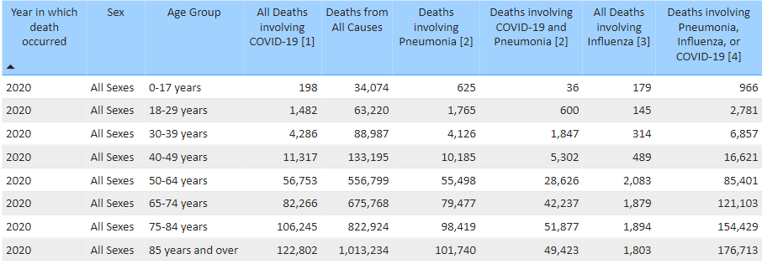


Slide 38
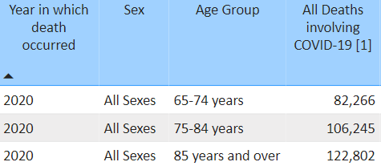

Slide 39
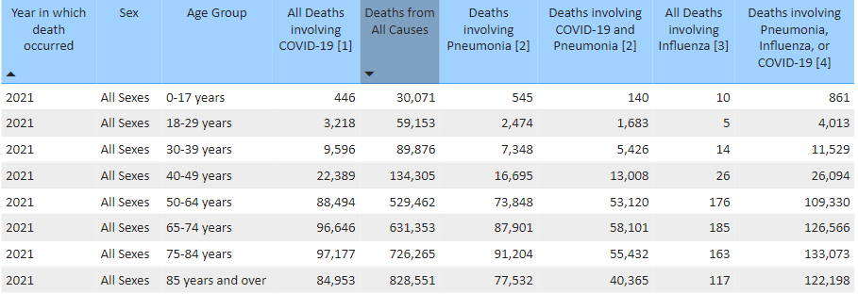

Slide 40
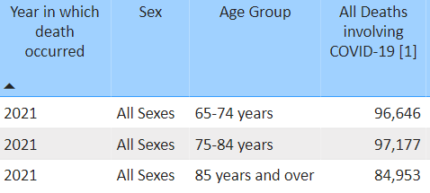

Slide 41
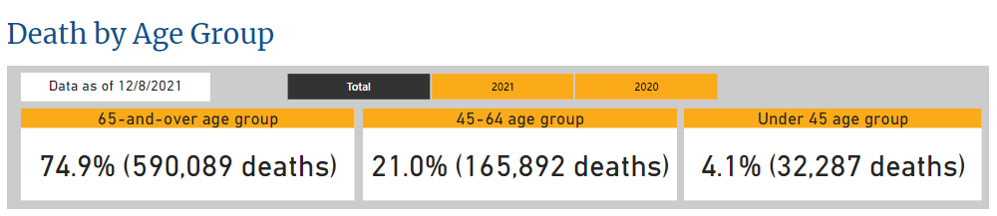

Slide 42
COVID-19 and Elderly
Adults 65 and older accounted for
31% of confirmed cases
45% of hospitalizations (Unlike young adults aged )
53% of ICU admissions
80% of deaths
In contrast with adults aged 20-54 who are responsible for 38% of hospitalization and 48% of ICU admission in adults younger than 65

Slide 43
Overdose Mortality
Age | Drug Overdose Death
0-24 | 7%
25-34 | 27%
35-45 | 25%
45-55 | 20%
55+ | 19%

Slide 44
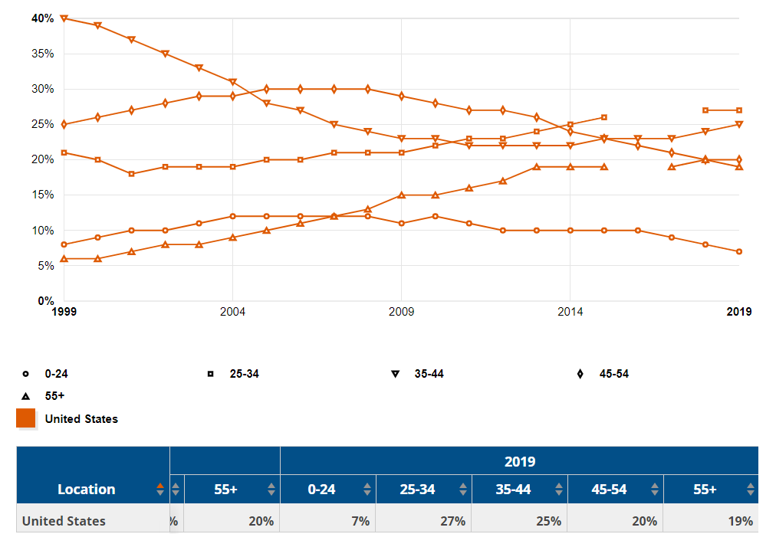

Slide 45
Over 65 – 74% of from COVID-19
  Experience, Wisdom, Culture and History
-----------------------------------------------------------------Under 55 – 79% of Drug overdose deaths
  Youthful vigor, Promise, Talent, Future

Slide 46


Slide 47
References
https://covid19.who.int/
https://www.cdc.gov/nchs/covid19/mortality-overview.htm
CDC. Severe Outcomes Amongst Patients with Coronavirus Disease 2019 (COVID-19)- United States, February 12- March 16, 2020
https://www.cdc.gov/nchs/nvss/vsrr/covid_weekly/index.htm#SexAndAge
https://www.cdc.gov/drugoverdose/nonfatal/pdf/COVID-19-Nonfatal-Drug-Overdose-Data-508c.pdf
Neria, Y., Nandi, A., & Galea, S. (2008). Post-traumatic stress disorder following disasters: A systematic review. Psychological Medicine, 38(4), 467-480. doi:10.1017/S0033291707001353
https://www.kff.org/coronavirus-covid-19/issue-brief/the-implications-of-covid-19-for-mental-health-and-substance-use/
Dubey Et al 2020. COVID-19 and addiction. Diabetes and Metabolic Syndrome Clinical Research and Reviews. 14. 817-823. 10.1016/j.dsx.2020.06.008.
Svetla Slavova Et al, Signal of increased opioid overdose during COVID-19 from emergency medical services data, Drug and Alcohol Dependence https://doi.org/10.1016/j.drugalcdep.2020.108176.
Nancy Glober et al- Impact of COVID-19 Pandemic on Drug Overdoses in Indianapolis https://doi.org/10.1007/s11524-020-00484-0
Yan Sun et al- https://doi.org/10.1111/ajad.13066
https://www.kff.org/other/state-indicator/opioid-overdose-deaths-by-age-group/?dataView=1&currentTimeframe=0&selectedDistributions=0-24--25-34--35-44--45-54--55&selectedRows=%7B%22wrapups%22:%7B%22united-states%22:%7B%7D%7D%7D&sortModel=%7B%22colId%22:%22Location%22,%22sort%22:%22asc%22%7D
https://www.commonwealthfund.org/blog/2021/drug-overdose-toll-2020-and-near-term-actions-addressing-it

